Slide 1
George Pacheco Evolutionary Biologist
Academic Introduction
27 August 2022
Oslo, Norway

Slide 2
Agenda
Early Scientific Inclinations & Initial Education
Previous Projects (MSc & PhD | University of Copenhagen)
Parallel Collaborations
Current Projects (Postdoc | Technical University of Denmark)

Slide 3
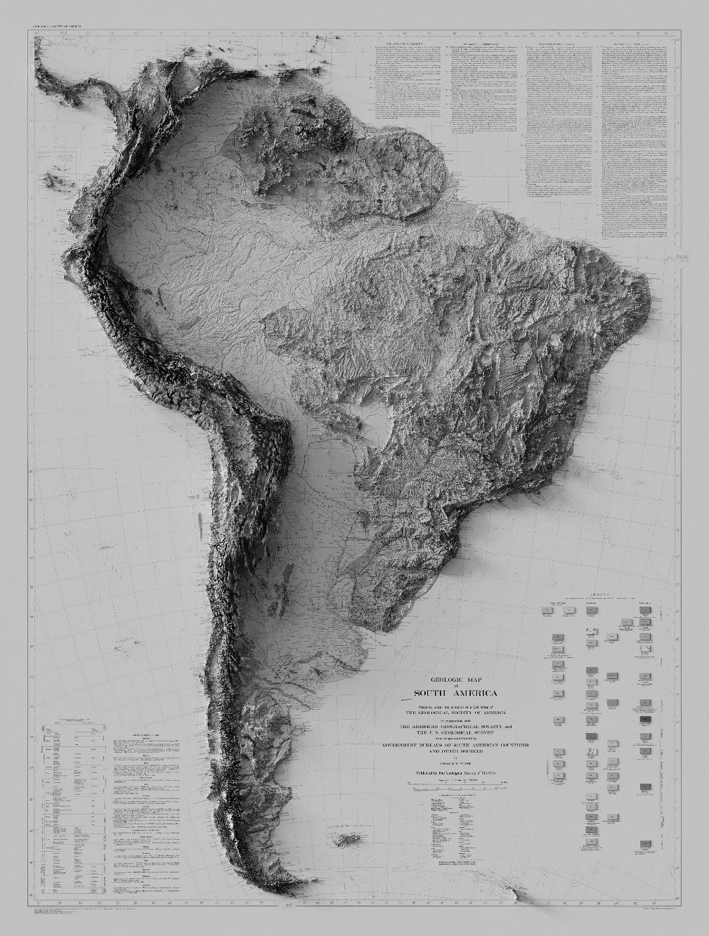
Early Scientific Inclinations & Initial Education

Slide 4
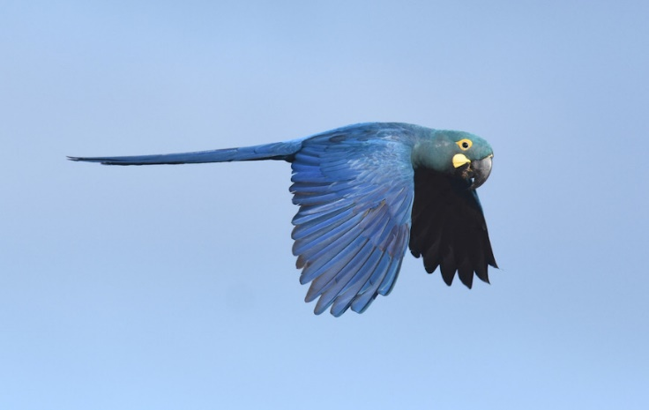
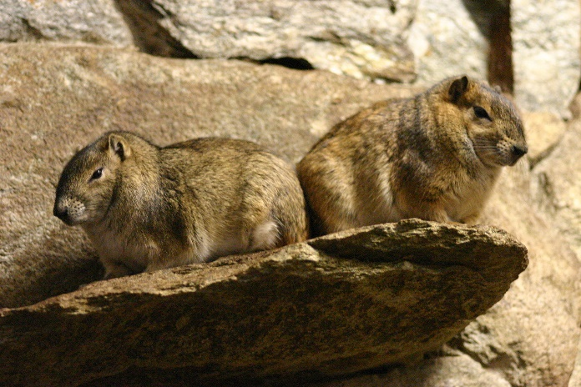
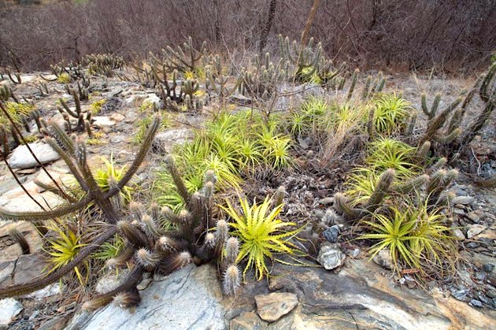
Early Scientific Inclinations & Initial Education

Slide 5
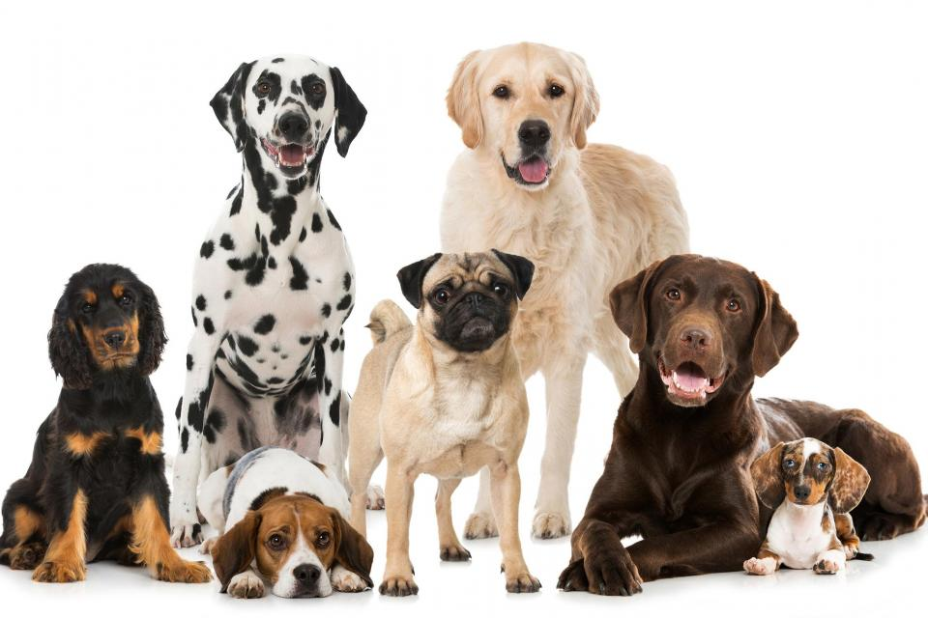
Early Scientific Inclinations & Initial Education

Slide 6
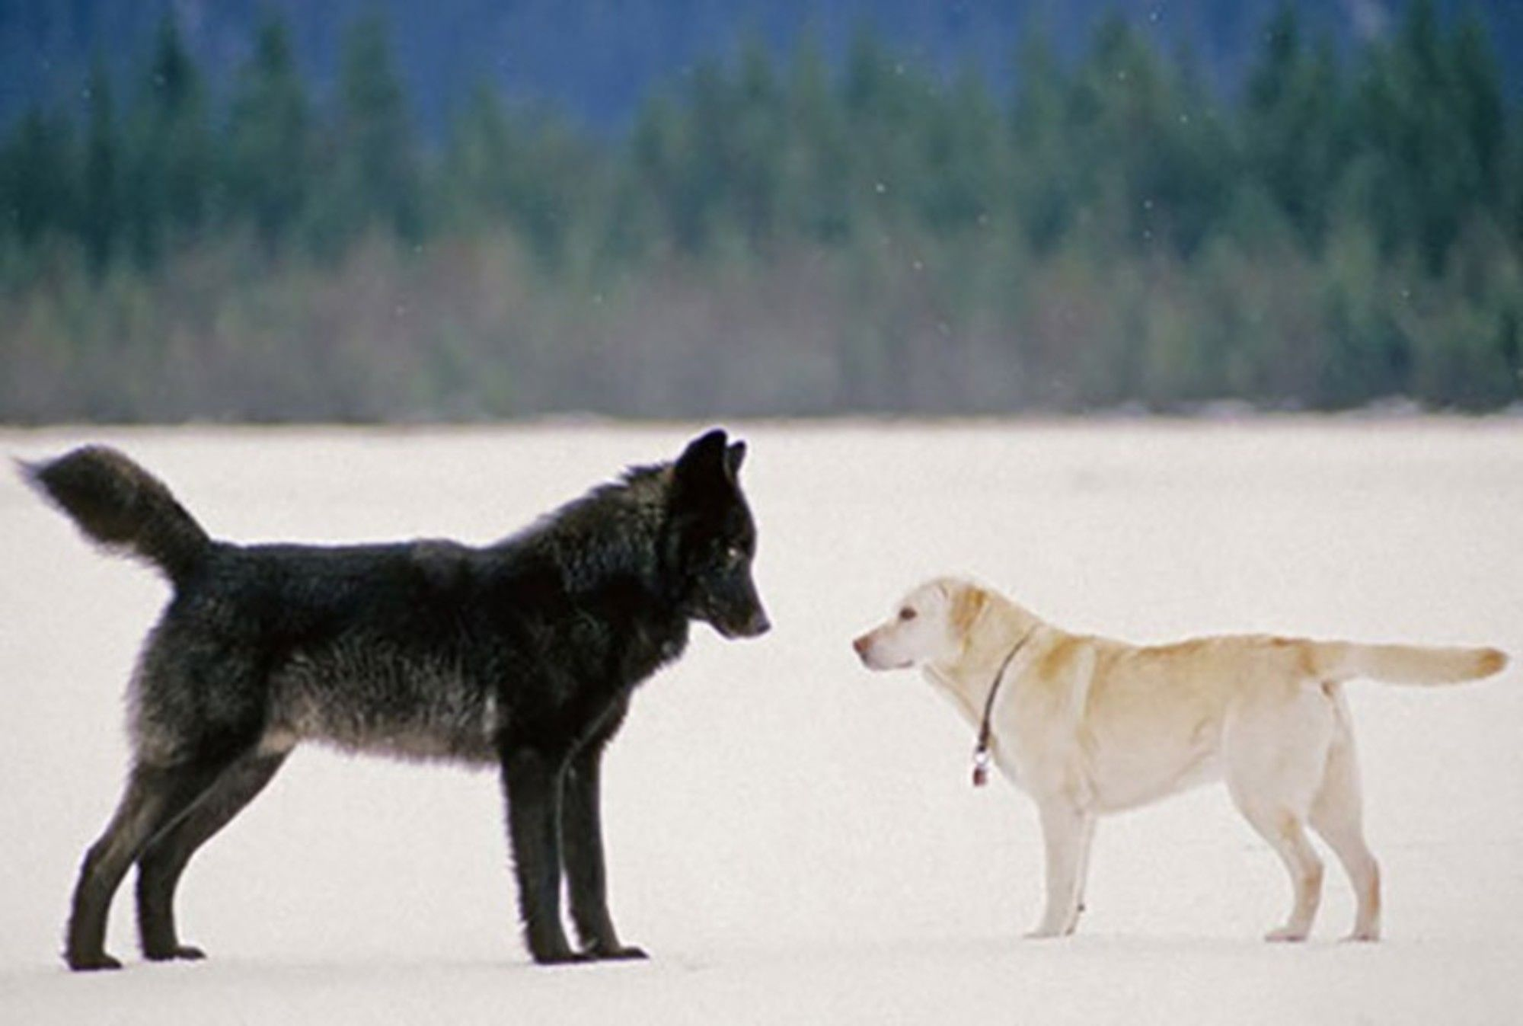
Early Scientific Inclinations & Initial Education

Slide 7
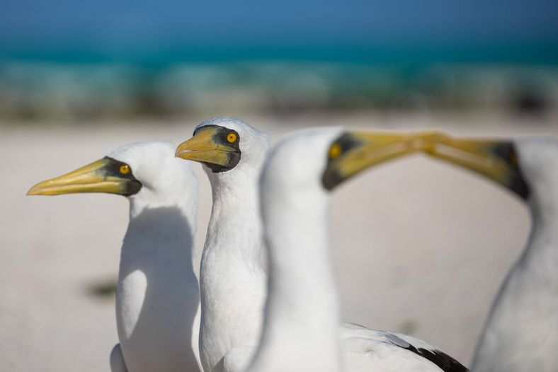
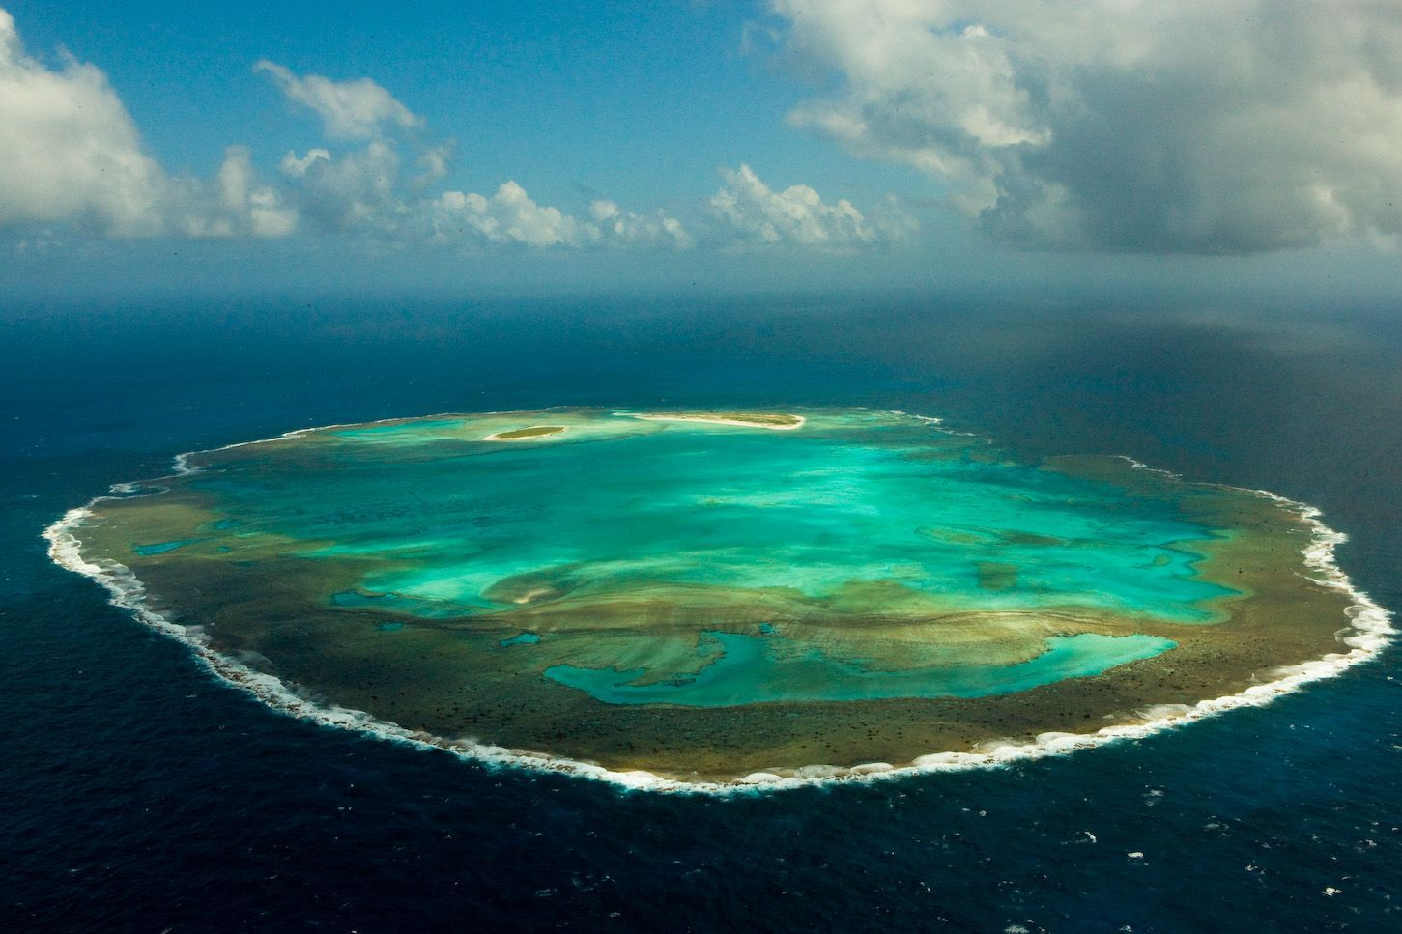
Early Scientific Inclinations & Initial Education
BSc in Biological Sciences
Rocas Atoll

Slide 8



Specialised Education | Genomics of Pigeons
MSc in Biology Danish Government Scholarship
PhD in Evolutionary Genomics Brazilian Science without Borders Scholarship

Slide 9
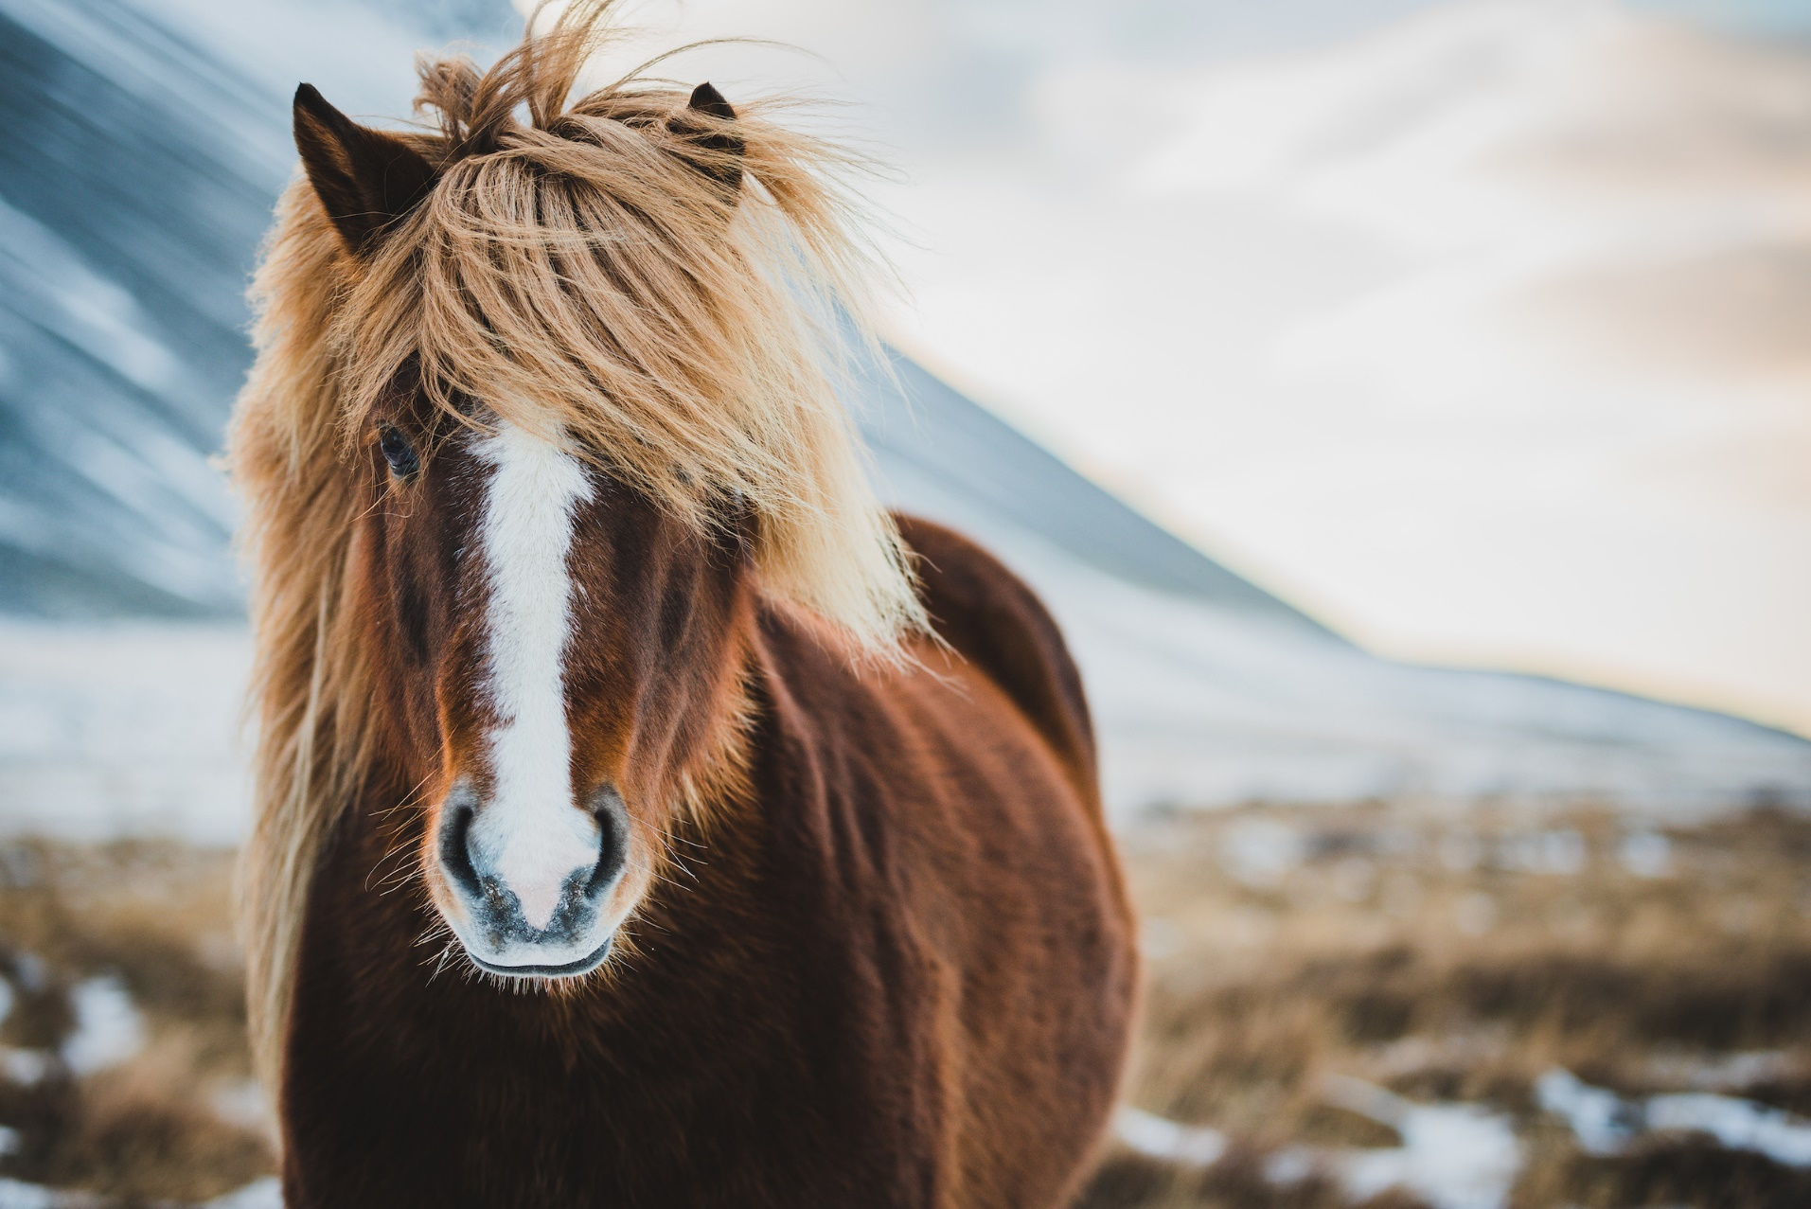
Specialised Education | Genomics of Pigeons

Slide 10

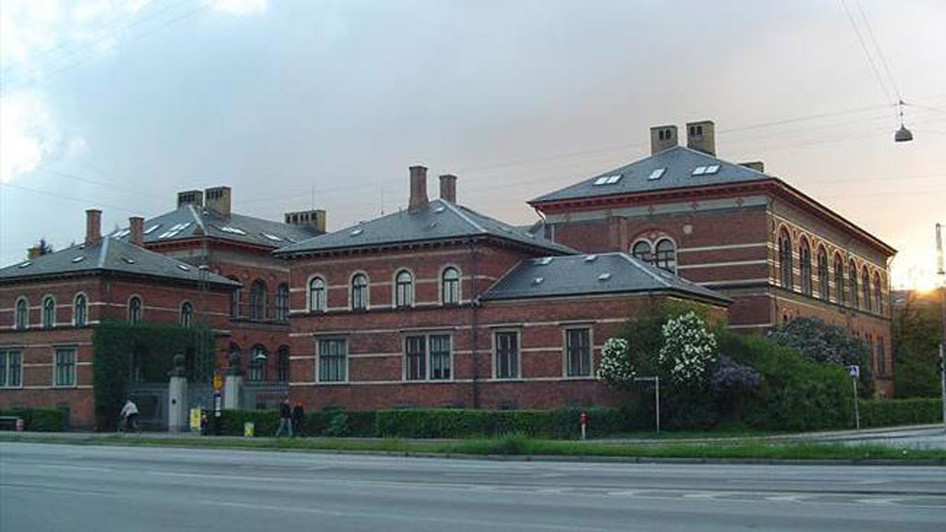
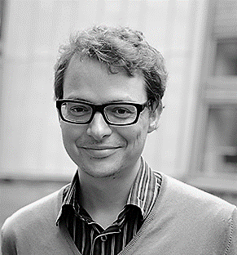
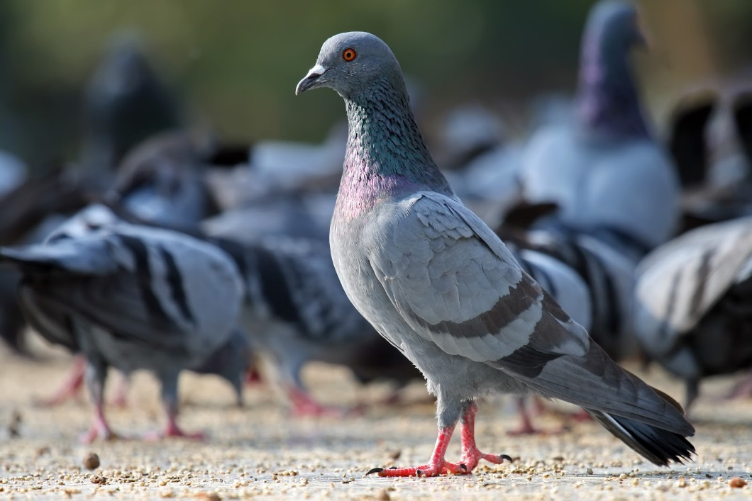
Specialised Education | Genomics of Pigeons
Natural History Museum of Denmark
Section for Evolutionary Genomics
Professor Thomas Gilbert
Domestication of Pigeons

Slide 11
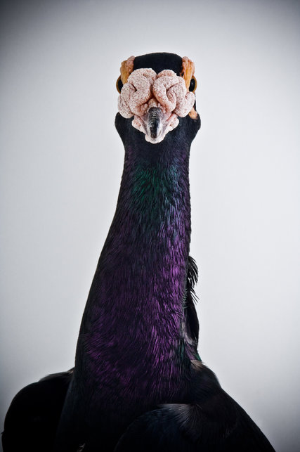
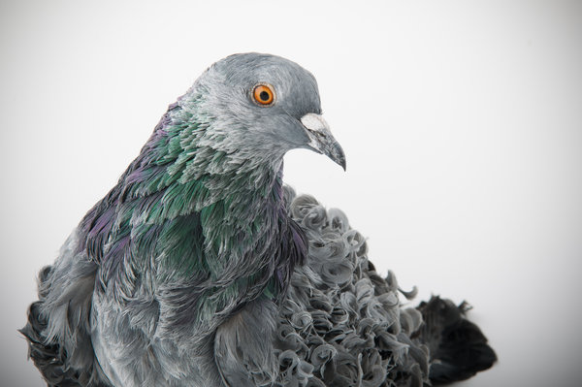
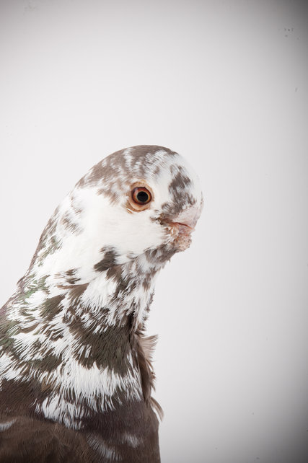
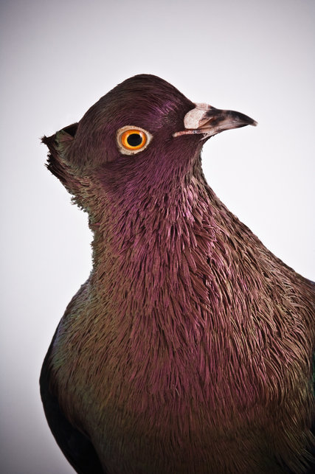
Specialised Education | Genomics of Pigeons

Slide 12
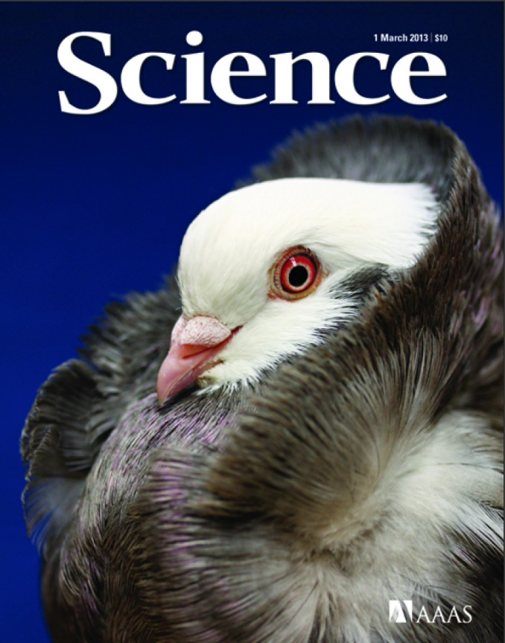
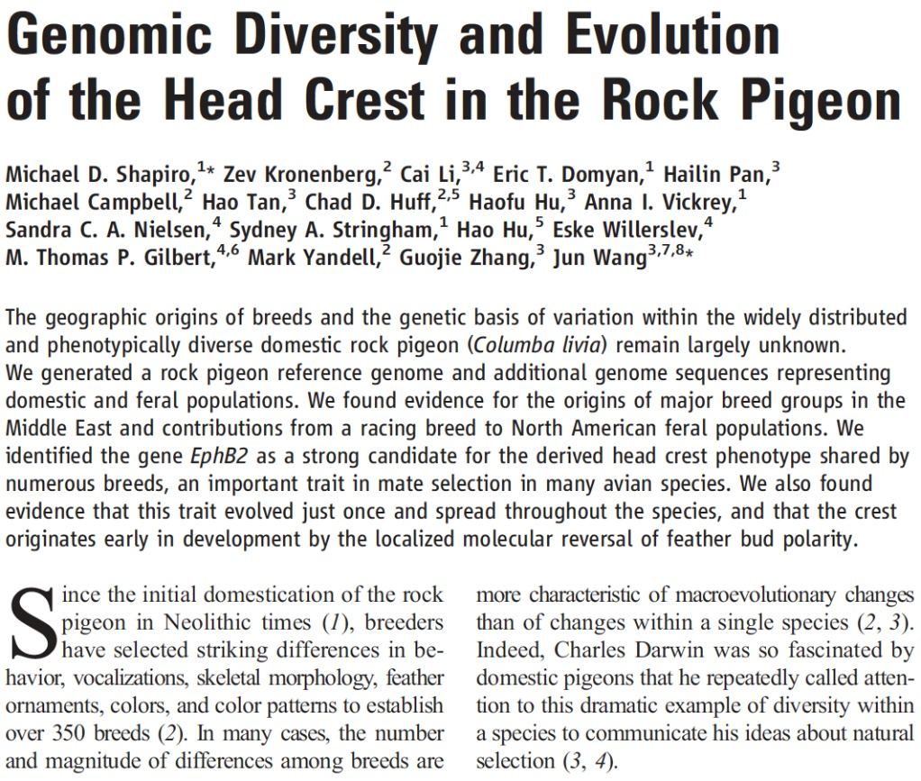
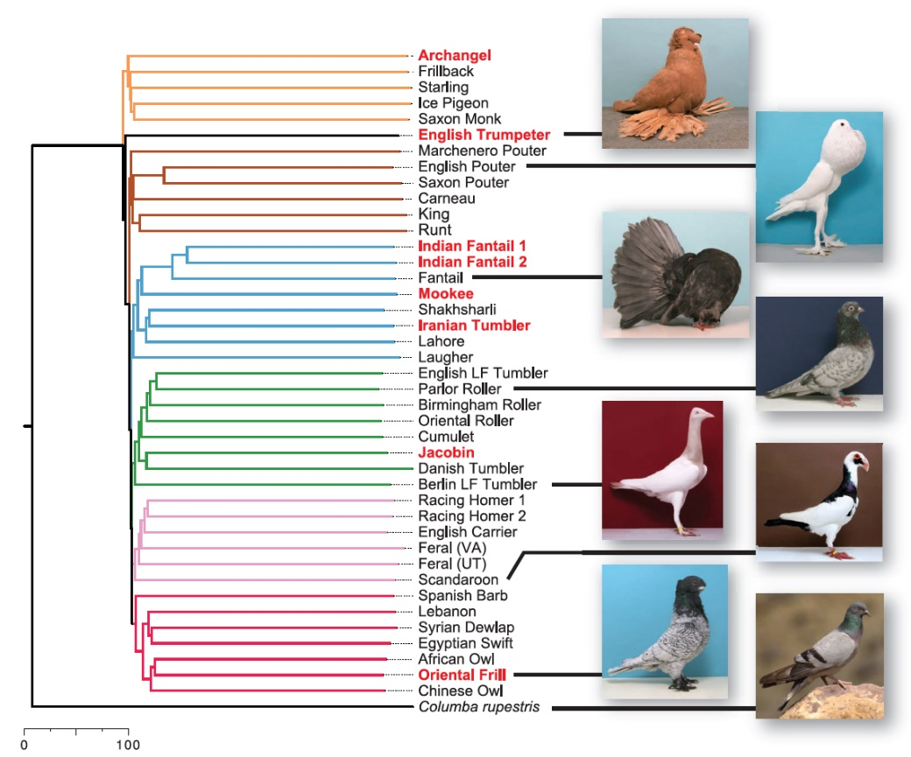
Specialised Education | Genomics of Pigeons

Slide 13
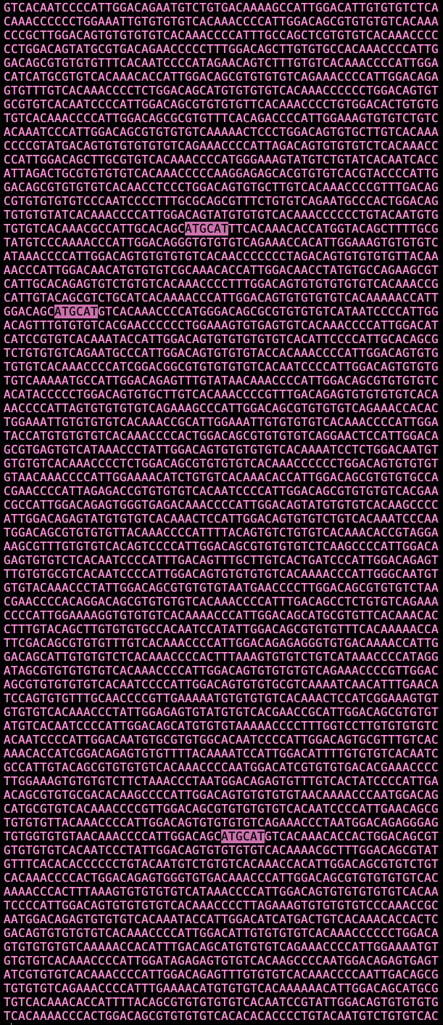
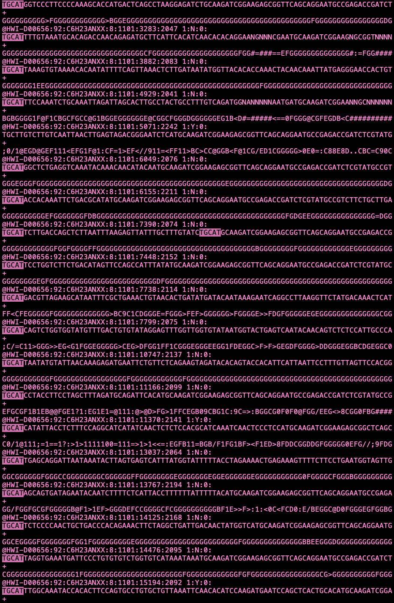
Specialised Education | Genomics of Pigeons
GBSing
(EcoT22I)

Slide 14
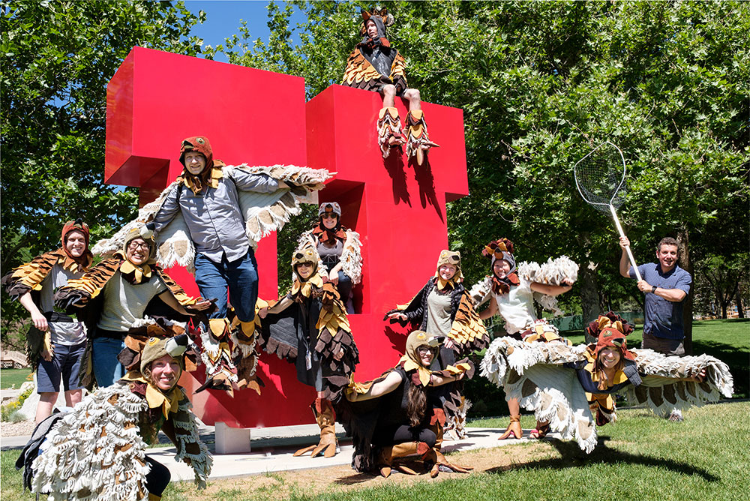
Specialised Education | Genomics of Pigeons
Research Visit for 1 month
+ 200 samples processed Mike Shapiro’s Lab University of Utah

Slide 15


Specialised Education | Genomics of Pigeons
190 GBS Samples
(Our Study)
50 WGS Samples
(Shapiro et al., 2013; Domyan et al., 2016; Gazda et al., 2018)
A Robust, Simple Genotyping-by-Sequencing (GBS) Approach for High Diversity Species
PlosOne | Vol. 8, Issue 5 (2013)
Elshire et al.
Stacks: Building and Genotyping Loci De Novo from Short-read Sequences
G3: Genes, Genomes, Genetics | Vol. 1, Issue 3, pp. 171-182 (2011)
Catchen et al.

Slide 16
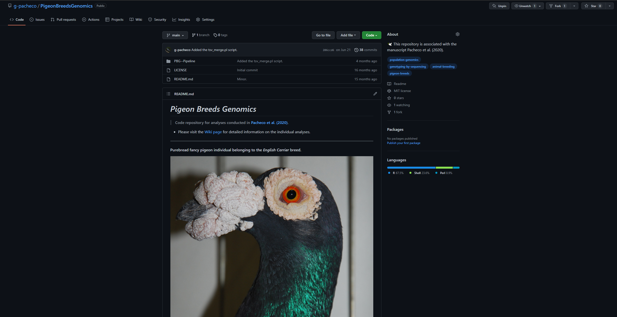
Specialised Education | Genomics of Pigeons

Slide 17
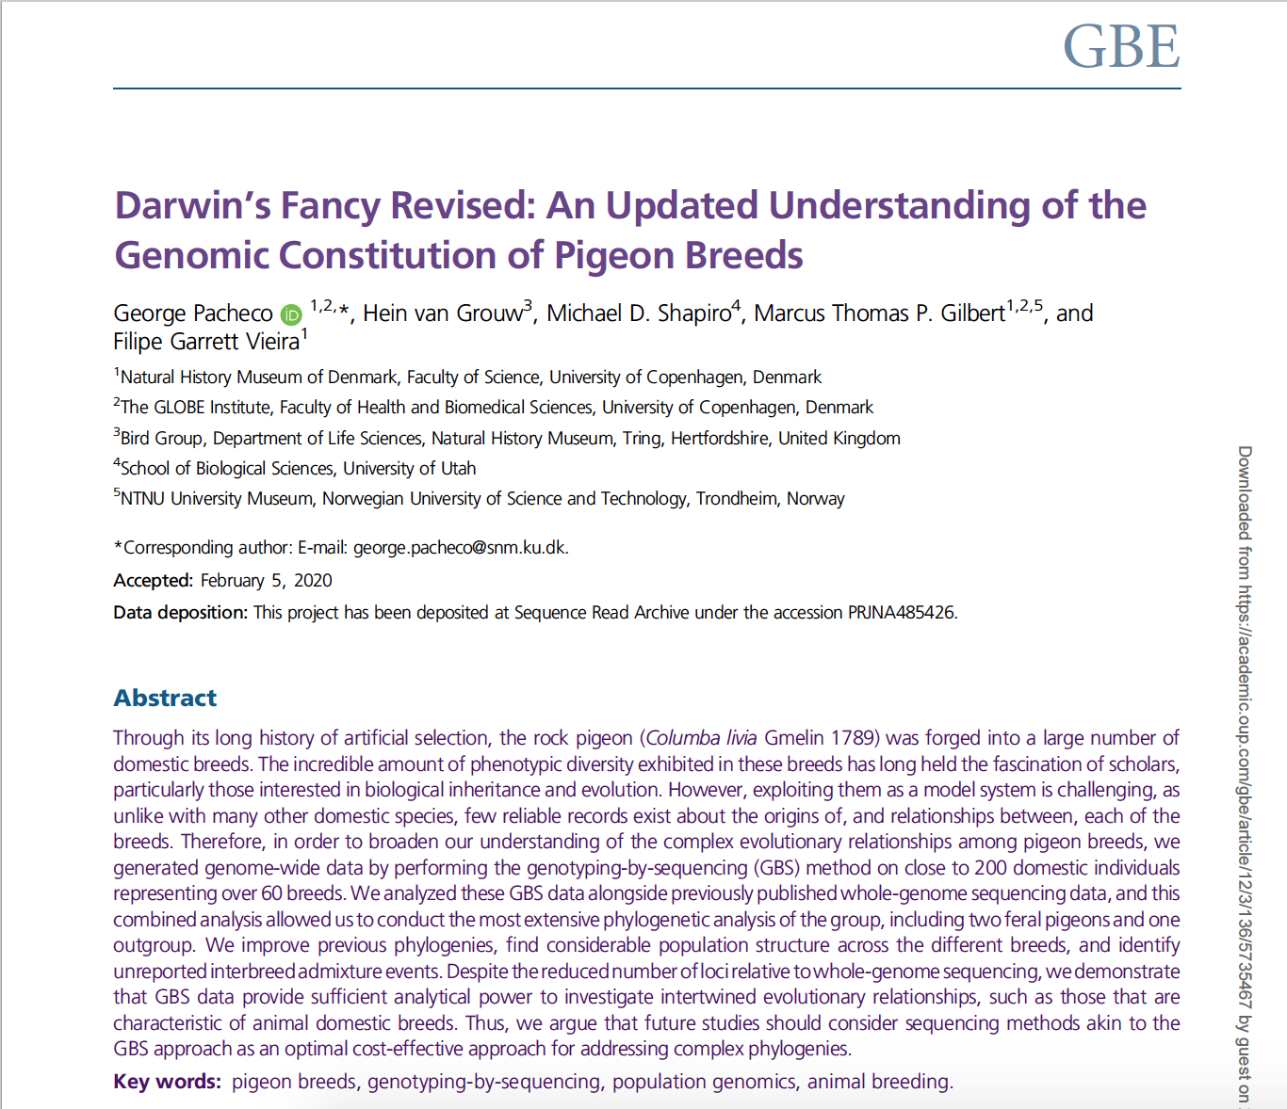
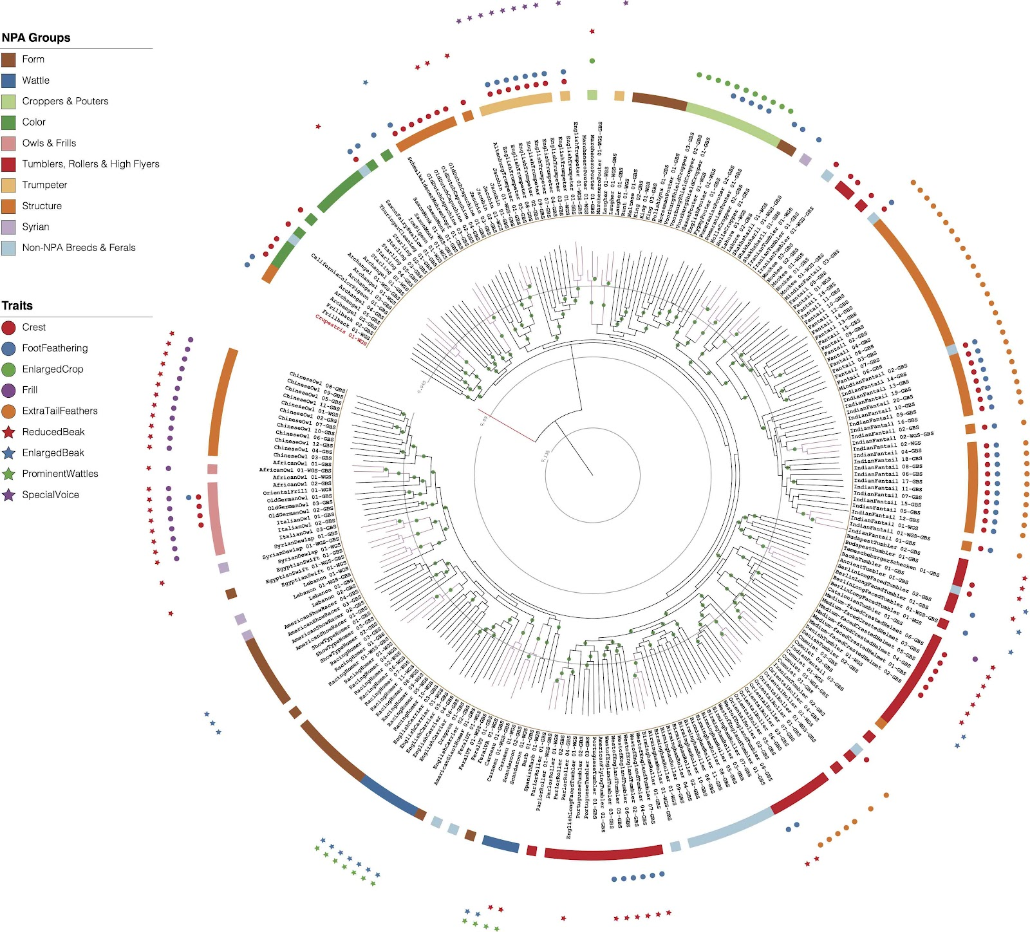
Specialised Education | Genomics of Pigeons

Slide 18
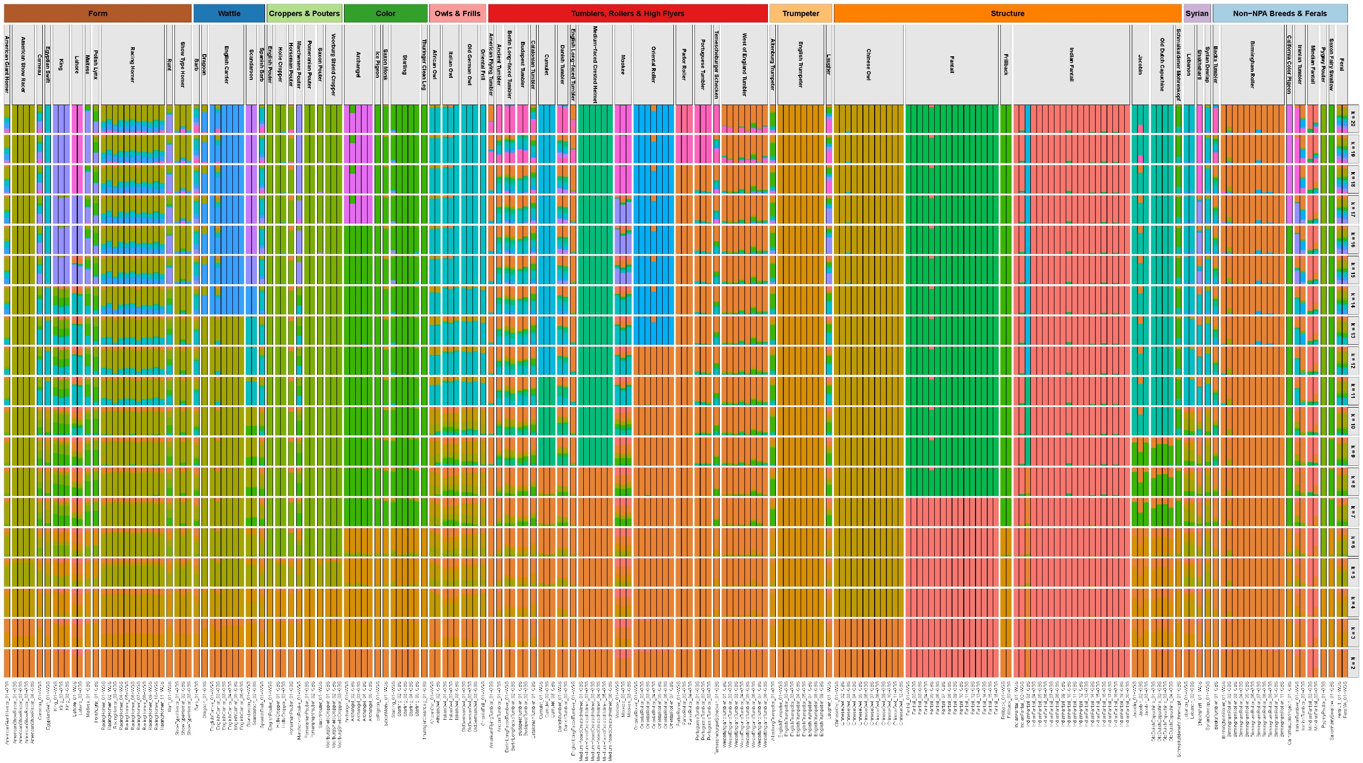
Specialised Education | Genomics of Pigeons

Slide 19
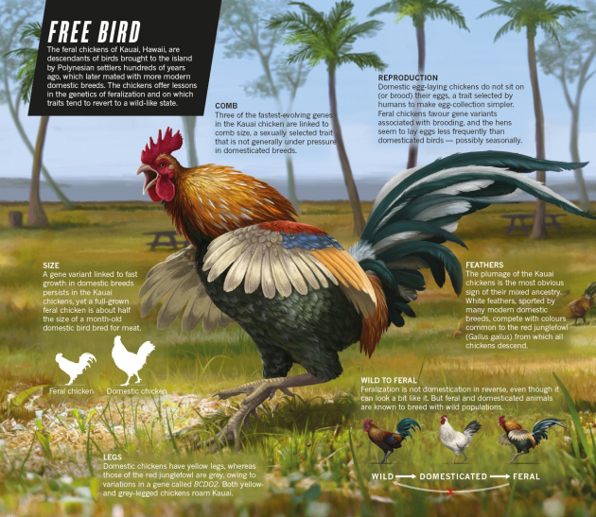
Specialised Education | Genomics of Pigeons
When Chickens Go Wild
Nature | Vol. 529:270-273
Ewen Callaway
Simply the Reverse of Domestication?
E.g. Dogs, Horses, Pigs, Cats (...)

Slide 20
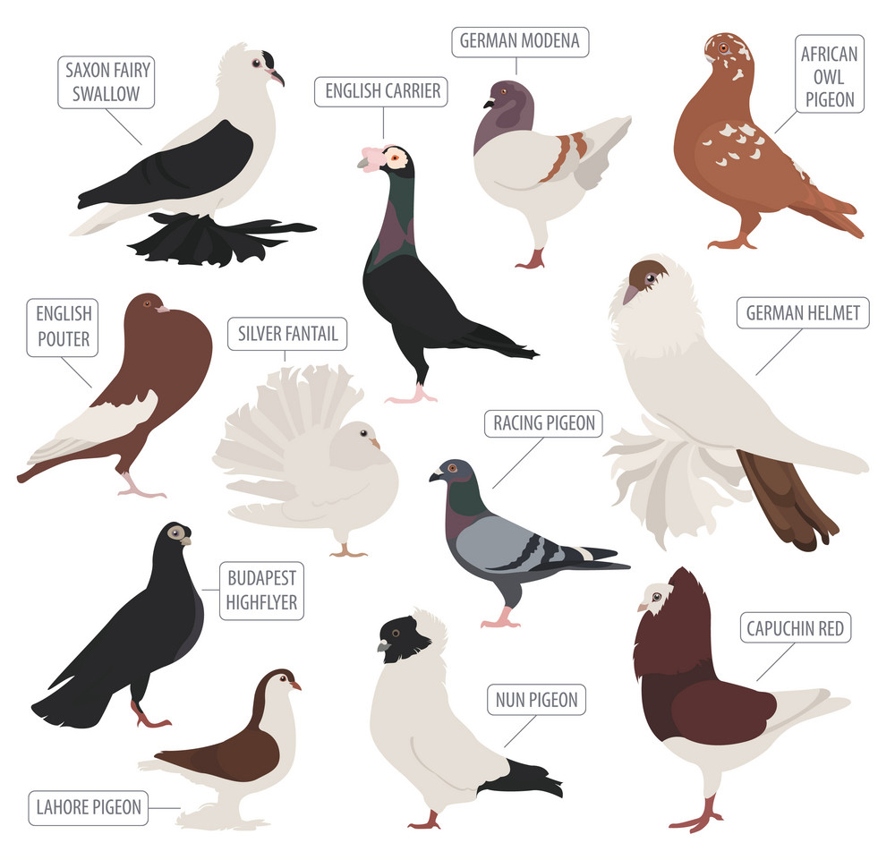
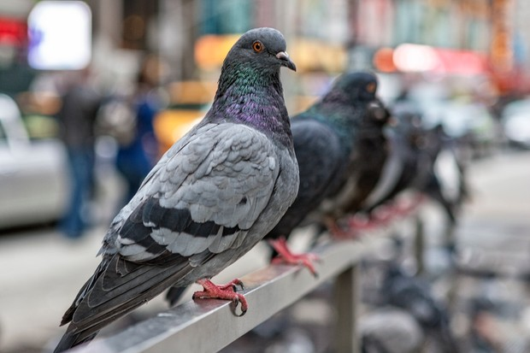
Specialised Education | Genomics of Pigeons
Feral Pigeon Populations?

Slide 21
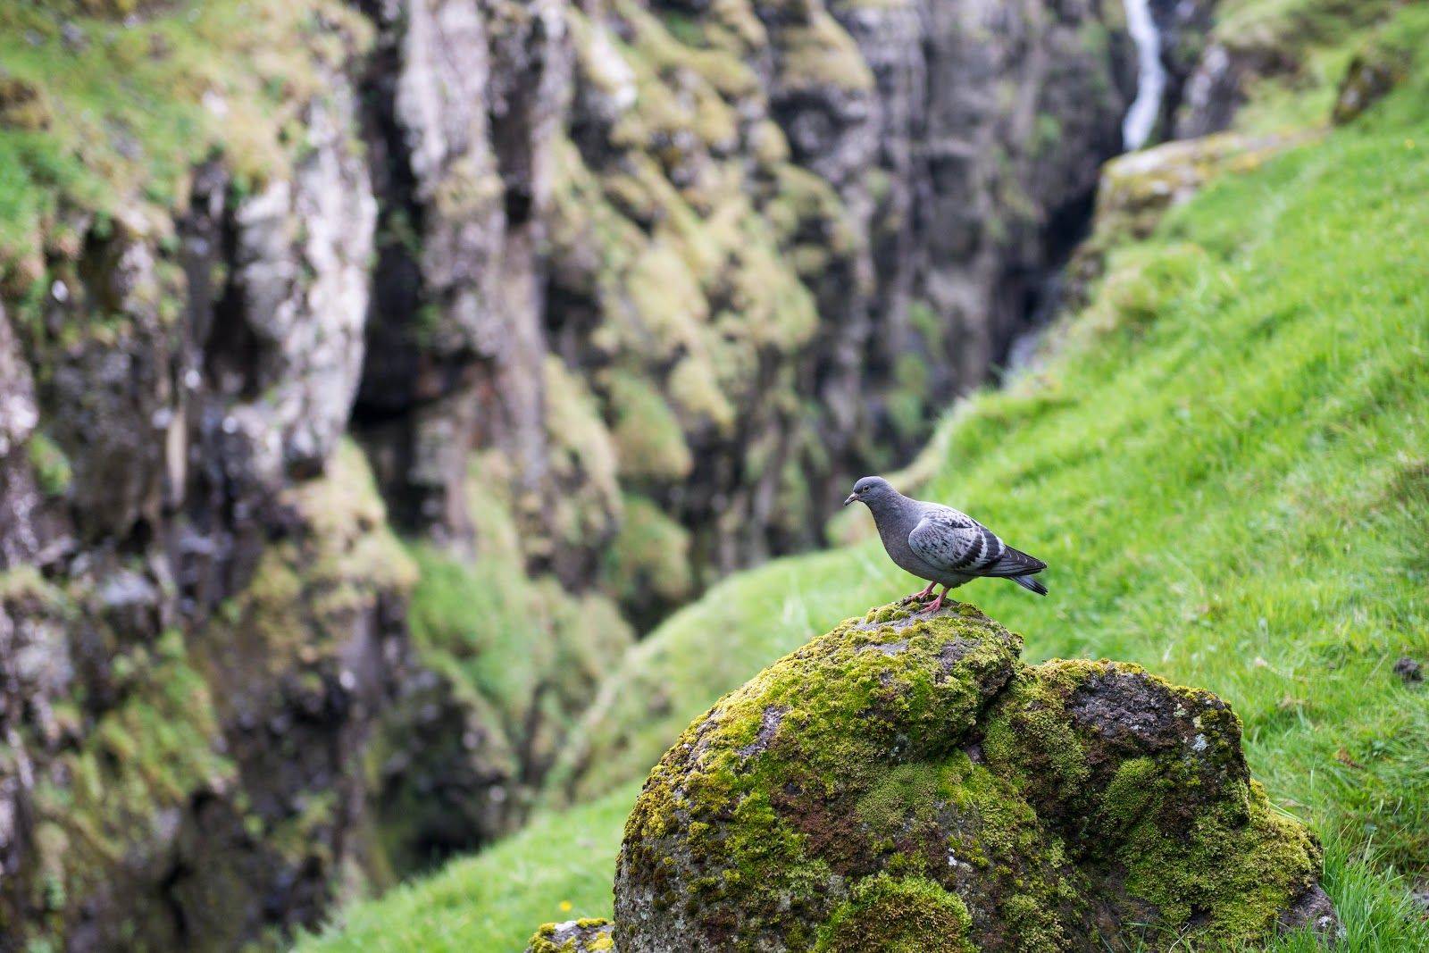
Specialised Education | Genomics of Pigeons
¿ Is there any wild rock dove colony left?
Rock Dove on the Faroe Islands: wild or not?
+700 samples
Covering All Continents
+30 Collaborators

Slide 22
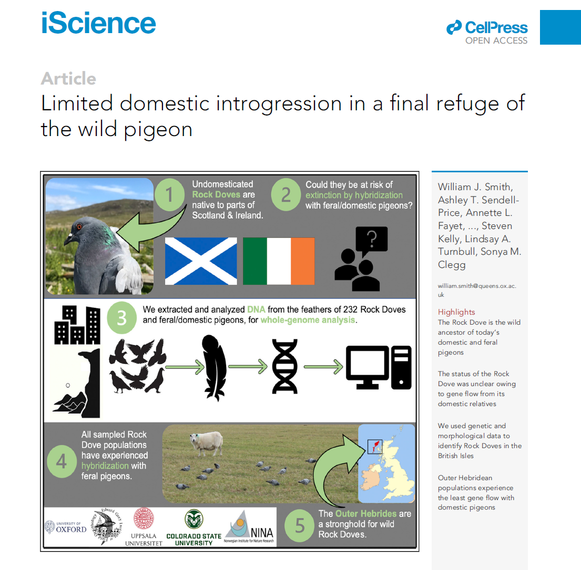
Specialised Education | Genomics of Pigeons

Slide 23
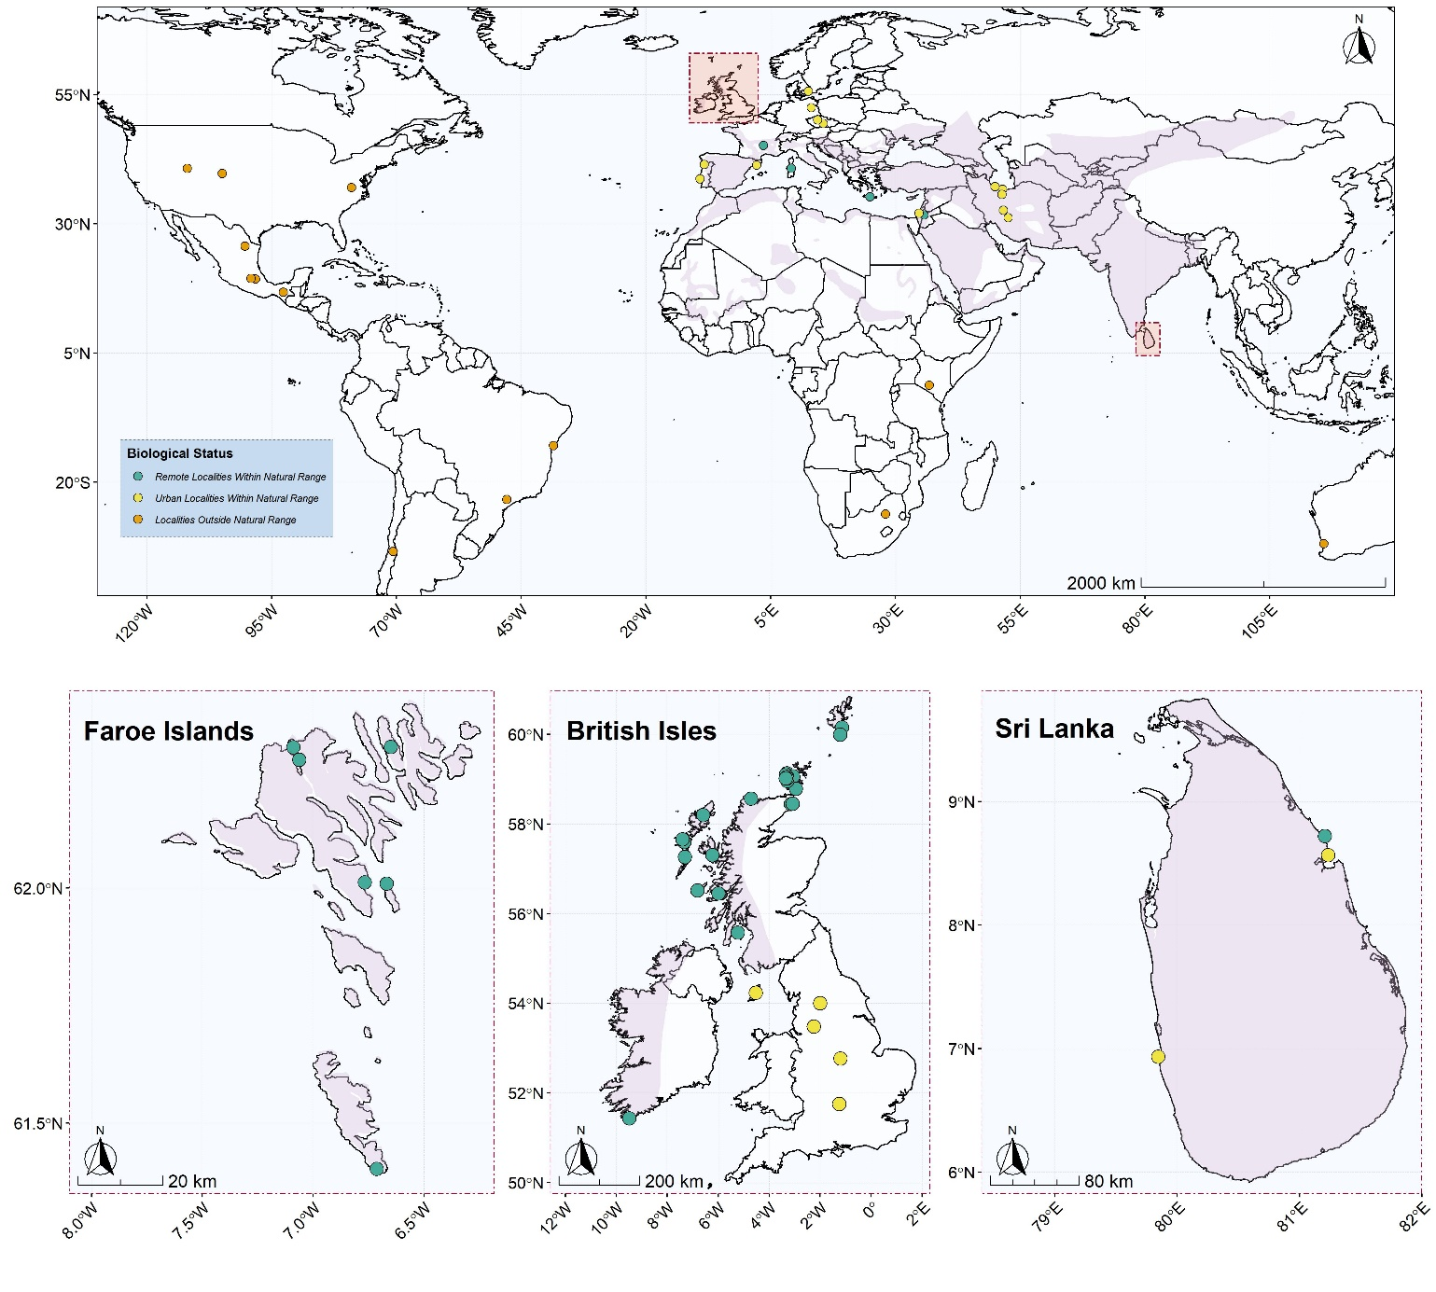
Specialised Education | Genomics of Pigeons

Slide 24
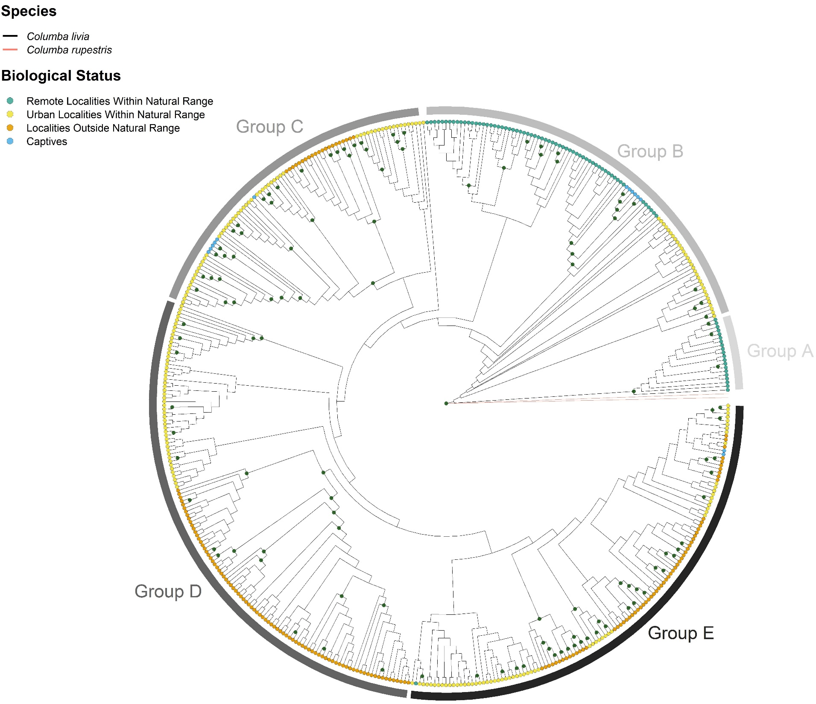
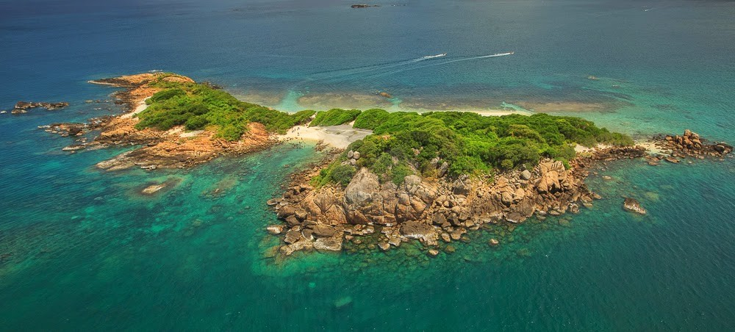
Specialised Education | Genomics of Pigeons
Pigeon Island National Park, Sri Lanka

Slide 25
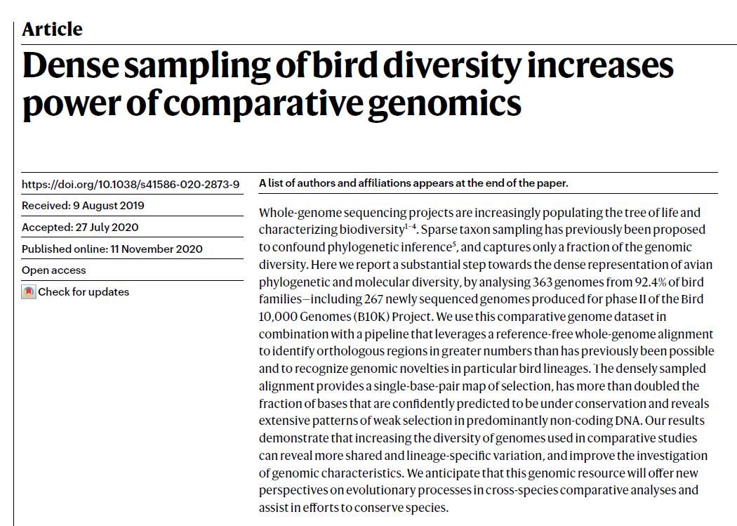
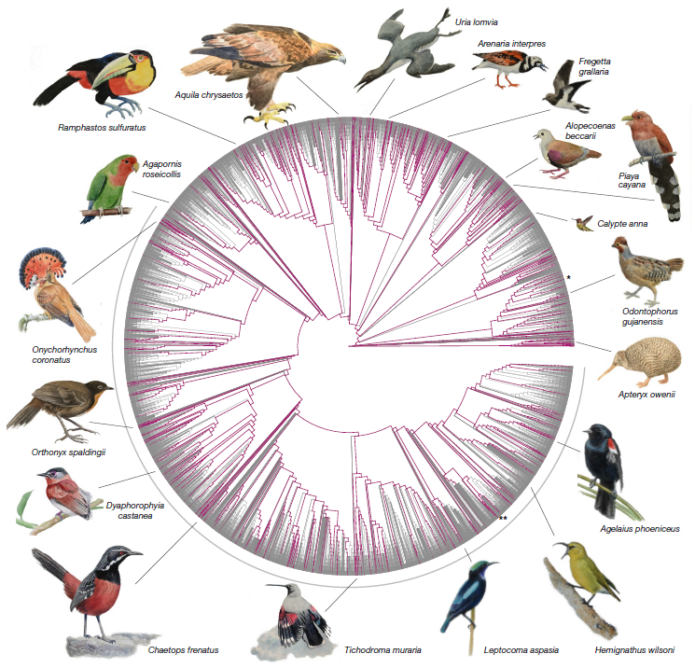
Parallel Collaborations | Bird 10K Project

Slide 26
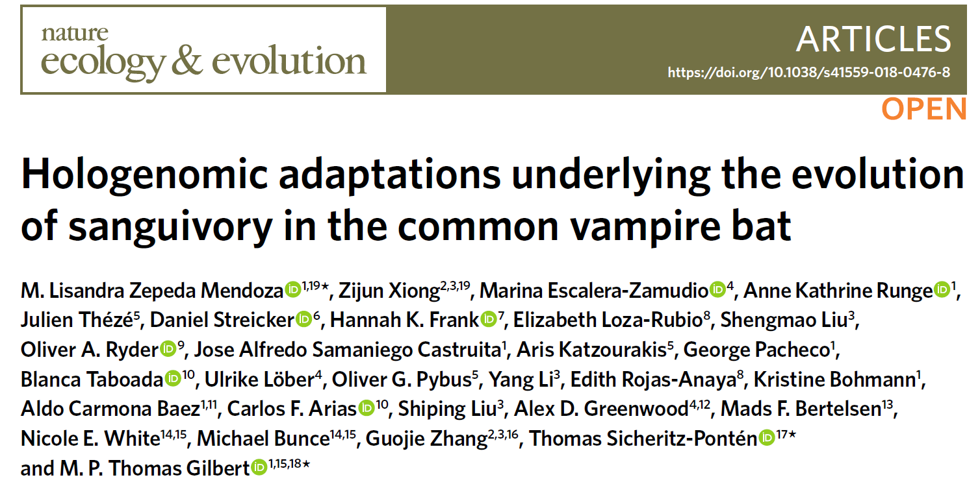
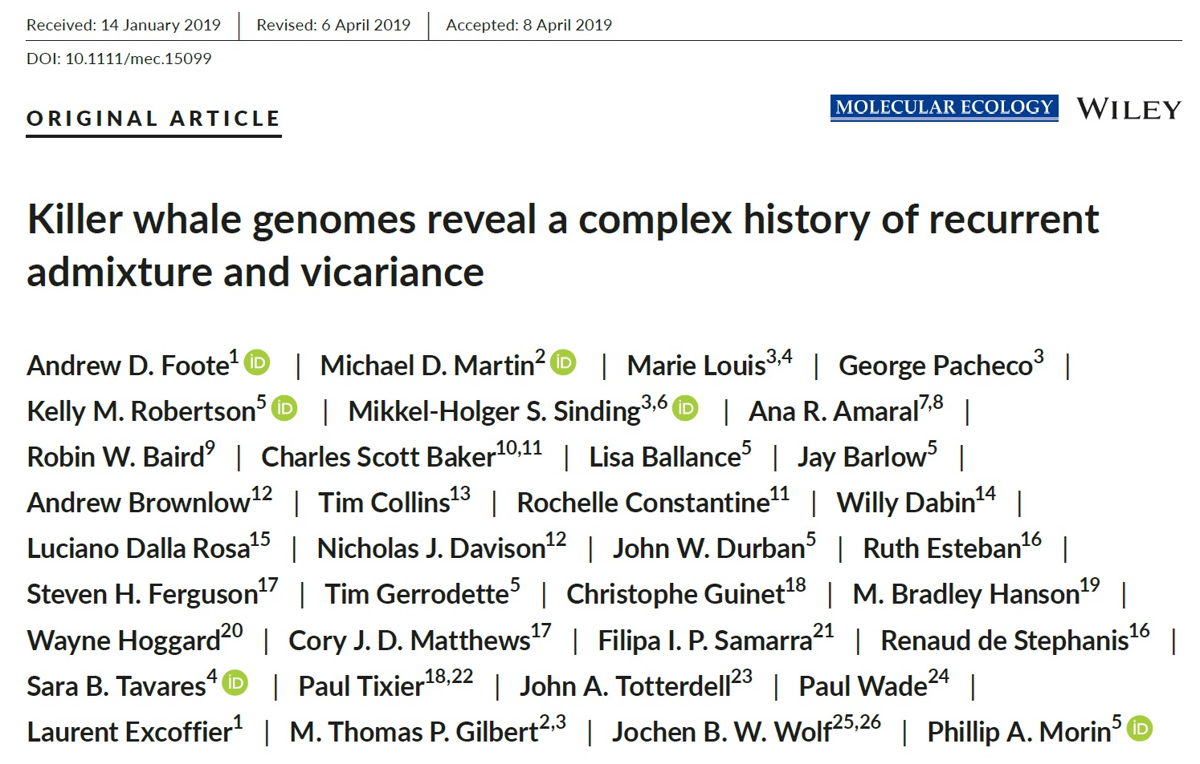
Parallel Collaborations | Other Projects

Slide 27
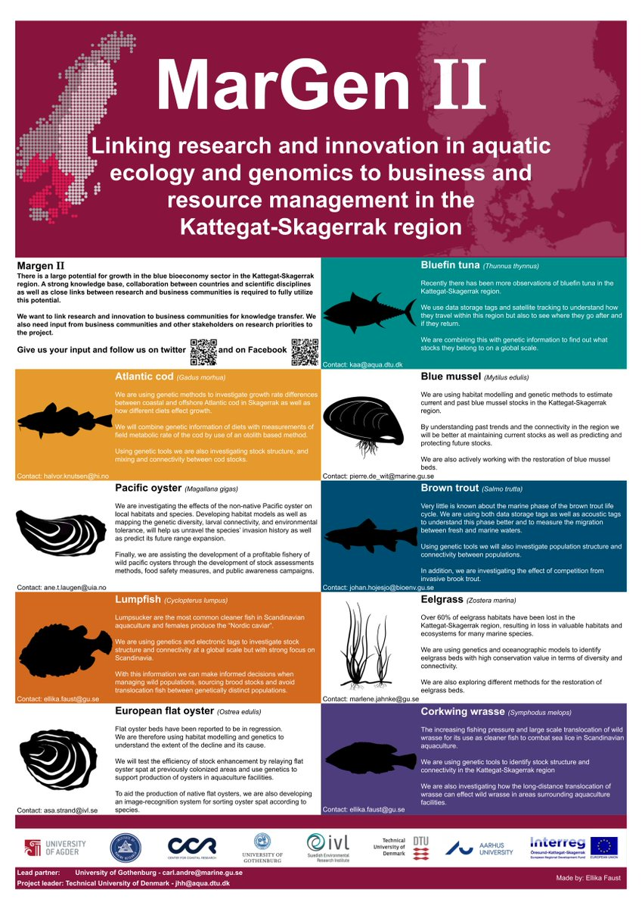
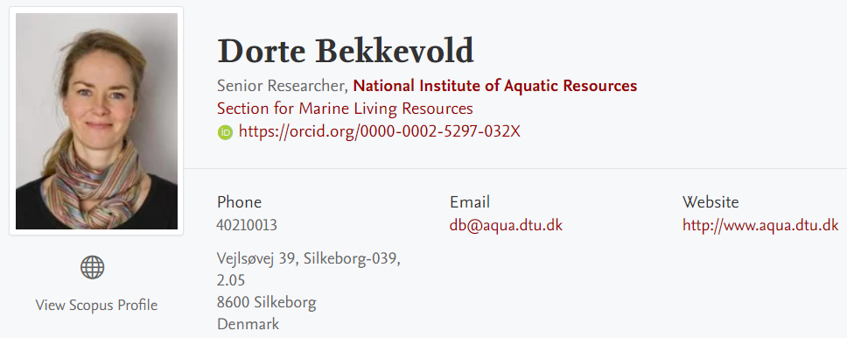
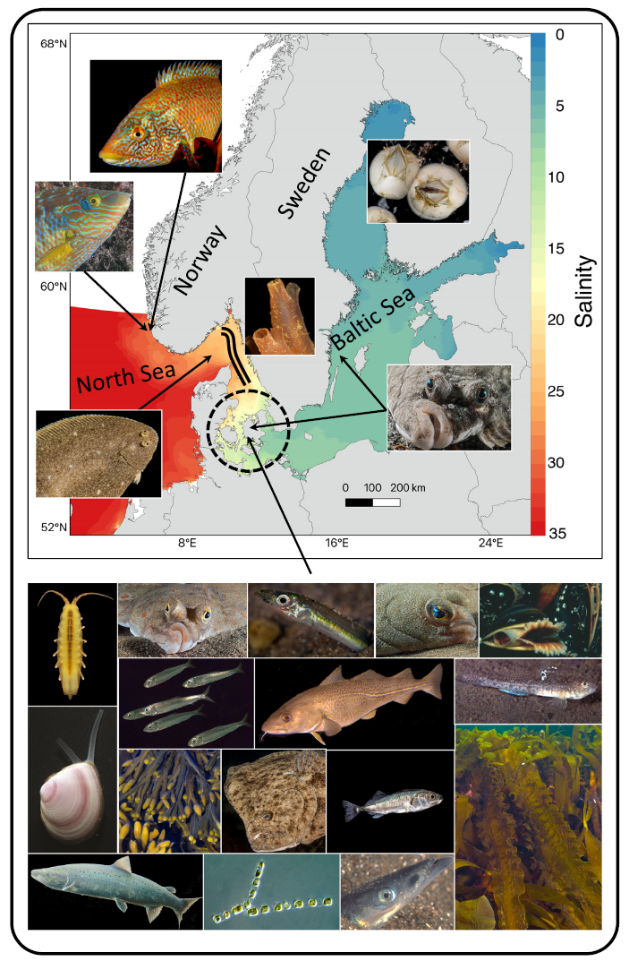
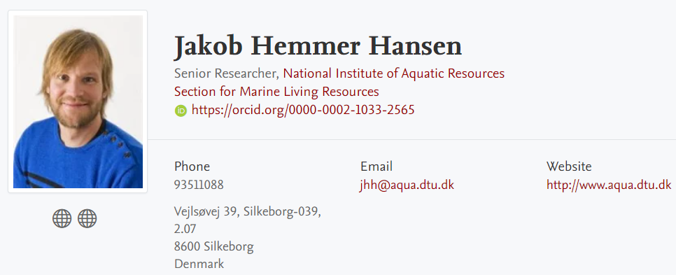
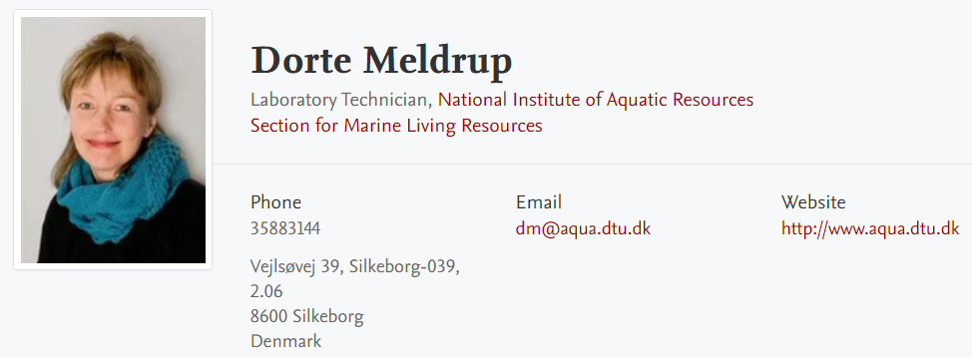
Past Project

Slide 28
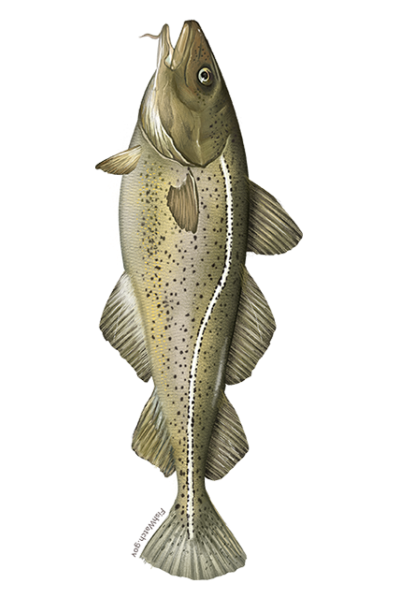
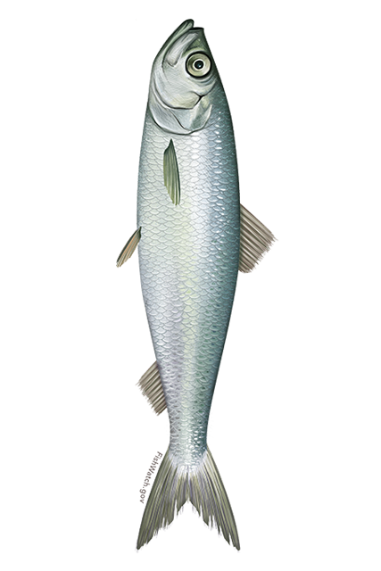
Past Project
WGS / Extreme Populations
Atlantic Cod (Gadidae)
Atlantic Herring (Clupeidae)
European Flounder (Pleuronectidae)
Turbot (Scophthalmidae)
Lumpfish (Cyclopteridae)

Slide 29
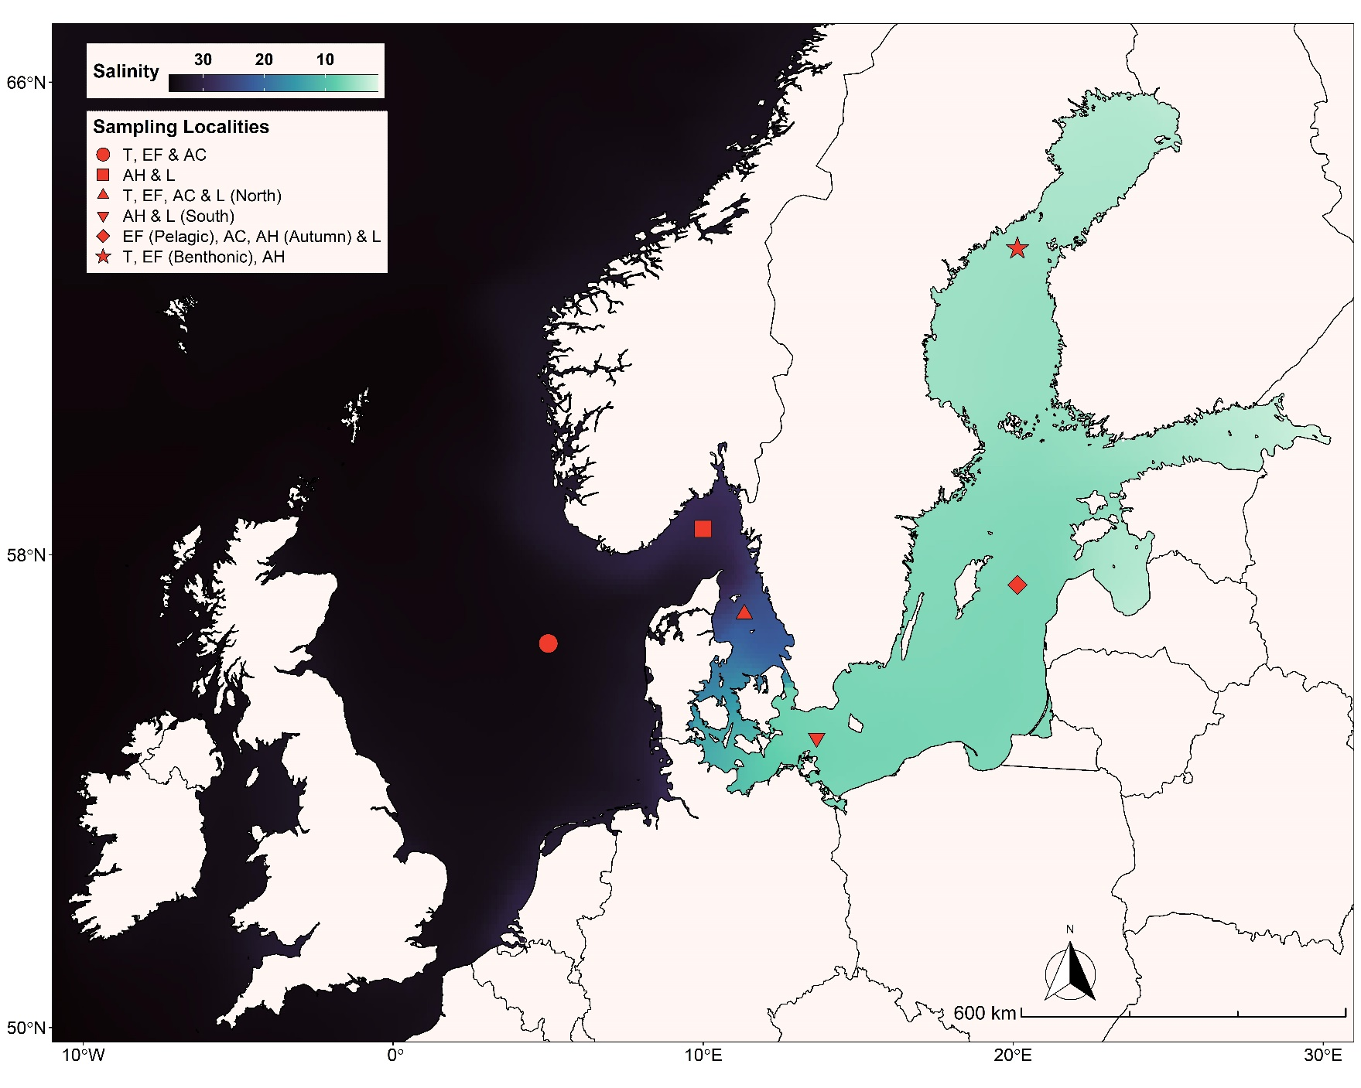
Past Project

Slide 30
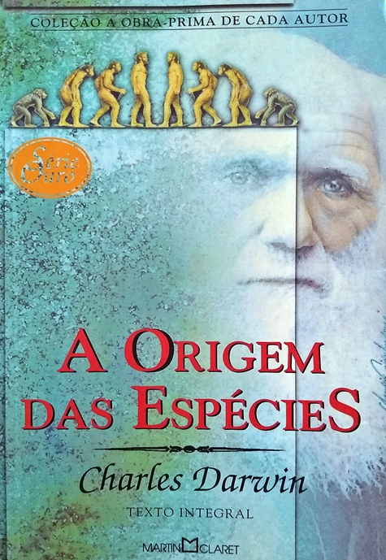
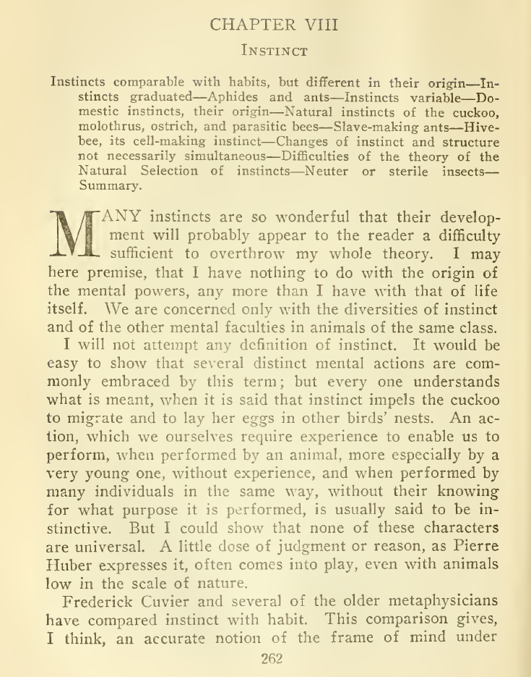
Future Perspectives

Slide 31
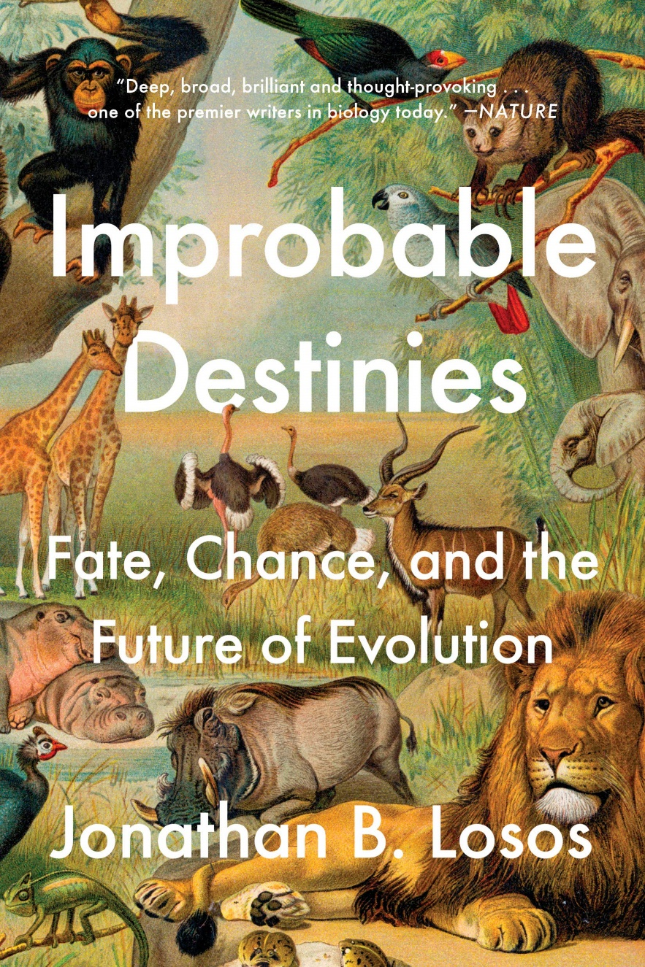

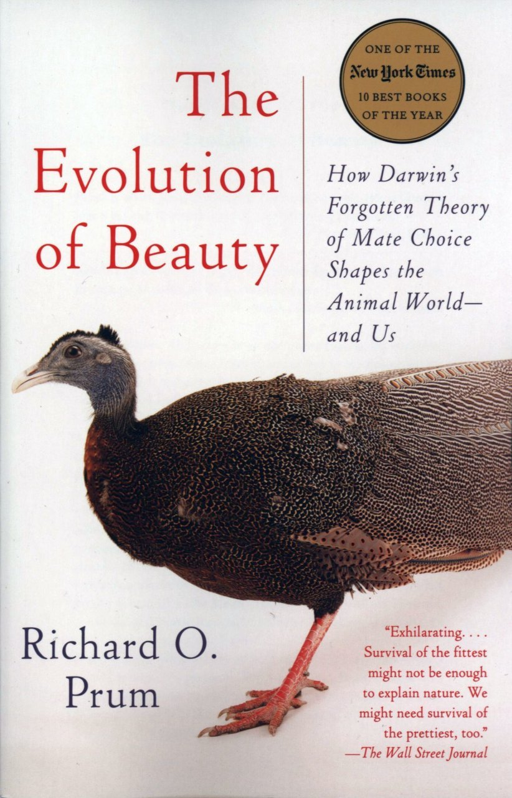
Future Perspectives

